Slide 1








Rights, Rules and Reporting Online
Lesson Plan
Junior Cycle

Slide 2

What we will cover in this lesson
Rights: You will consider the rights you have online.
Rules: You will learn about the new rules that exist in Ireland to regulate online platforms, and the role of Coimisiún na Meán, Ireland's media regulator.
Reporting: You will learn how to report content to online platforms and discuss scenarios in relation to reporting illegal content to Coimisiún na Meán.
Notes:
Time: 1 min

Slide 3



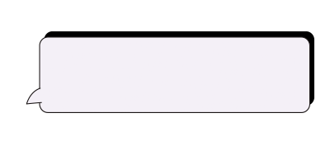


Your Rights Online
Notes:
This section of the lesson (slides 4–7) will explore children's rights online. Students will watch a short video and will answer some questions afterwards.

Slide 4
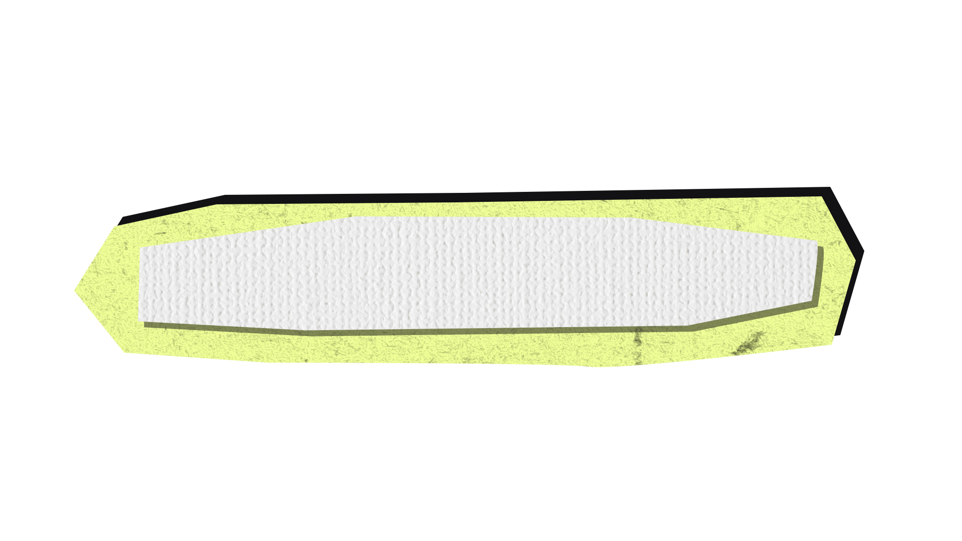


PAIR ACTIVITY
Knowing your rights
In pairs, in 60 seconds …
Write down 3 rights you have
Do you have any rights online? Name any you can think of.
You will need:
Paper, pen, a partner
Notes:
Time: 1–2 mins
Divide the class into pairs. Explain they need a piece of paper, a pen and a partner.
Using a class timer, or your watch, explain to the class that you will give them 60 seconds to write down as many rights they have, both in general and rights in the online space. You may choose to remind them that they learned about children’s rights under the United Nations Convention on the Rights of the Child in CSPE in 1st Year.
Feedback as a class. Did any group get more than 3 for question 1? Were students able to think of any rights they have online?
Suggested answers are on the next slide.

Slide 5

Children’s rights
Under the UN Convention on the Rights of the Child, children and young people under 18 have a range of different rights, including:
The right to education​
The right to healthcare​
The right to be protected from harm
​
The right to freedom of expression
​
The right to information​
The right to join groups
Children and young people also have rights online, including:
The right to privacy
The right to participate ​
The right to freedom of expression
​
The right to be protected from harm
Notes:
Time: 1 min
Your students will have already learned about children's rights. It's important for them to understand that the same rights apply to them online.
Further notes:
If you are under the age of 18, you are considered a child and you have children’s rights. Ireland ratified the Convention on the Rights of the Child (https://www.ohchr.org/en/instruments-mechanisms/instruments/convention-rights-child) in 1992 and, as such, agreed to the 42 rights outlined in this convention. Examples of these rights are in the slide above. For more information, you can look at www.oco.ie/rights or www.itsyourright.ie
In 2021, it was clarified under General Comment 25 (https://www.ohchr.org/en/documents/general-comments-and-recommendations/general-comment-no-25-2021-childrens-rights-relation) that children’s rights also exist online. However, enforcement of these rights has been an issue in the past. It may have felt like there were no consequences to those who broke rules in the past online.
Under the Online Safety Framework that Coimisiún na Meán enforces, this is now changed and this is what the video is about.

Slide 6
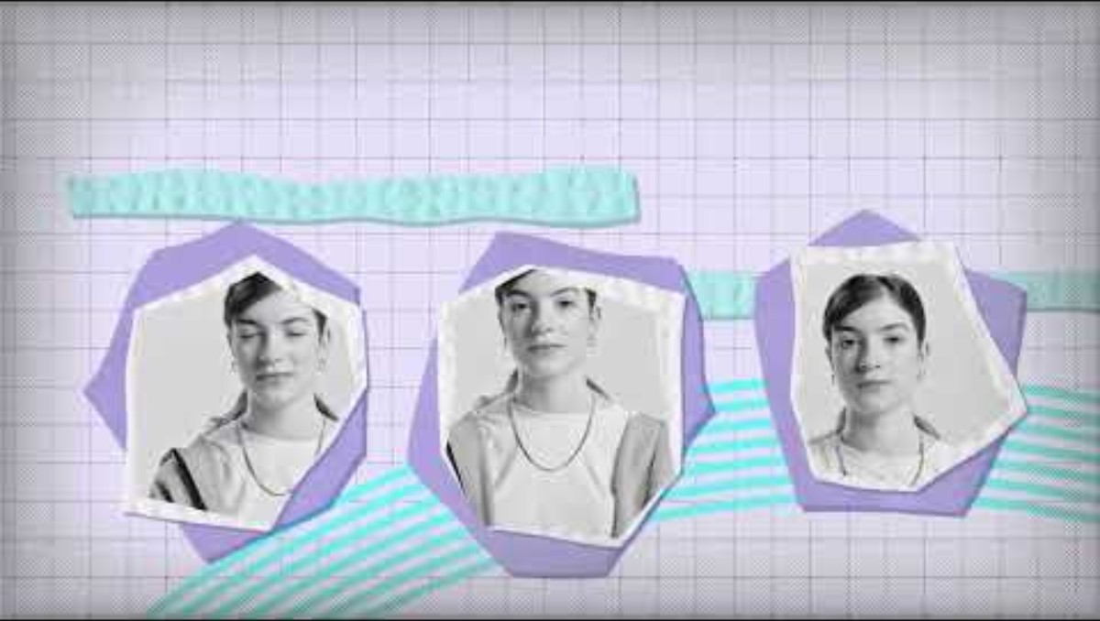
Your rights online
Notes:
Time: 3 mins
Explain to the class that you will show them a video that outlines rights they have online. Video link: https://www.youtube.com/watch?v=i-umcO3LQPM
Play the 2-minute video and explain that there are questions that follow.
You can choose whether the class should discuss these questions in groups, or if they should write their answers in their copies.

Slide 7

Questions about the video
1. The video highlights potential risks online for young people, including bullying, nasty comments and toxic feeds. Can you think of other risks that young people face online? What are they?
2. According to the video, there are new rules* that help protect young people’s rights online. What rights are highlighted in the video?
3. Under the ‘right to express yourself’, it says you need to be mindful about what you post or share online. Why does it say this? What responsibilities do we all have online?
4. According to the video, if you don’t know how to report something online, what can you do?
*In this context, rules are the same as laws.
Notes:
Time: 5–10 mins
Suggested answers:
Other risks online: Spam, fake accounts (impersonation), pornography, extreme violence, nasty comments, doxing, abuse, harassment, echo chambers, toxic feeds.
What 3 rights do these rules highlight? Right to report, right to express yourself, right to be protected from harm.
Responsibilities online: It is important that you don’t share nasty comments or upload intimate images of yourselves or others as this can be against the law. The right to freedom of expression is balanced. Although you have a right to freedom of expression (the right to express yourself), you do not have the right to say anything that might cause harm to others, e.g. hate speech or speech encouraging terrorist activities. It is important to be kind online.
What can you do: You can contact the Advice Centre at Coimisiún na Meán by emailing usersupport@cnam.ie

Slide 8
Rules online
Notes:
This section of the lesson (slides 9–11) provides information about the new laws that form the Online Safety Framework. This framework allows Coimisiún na Meán to do its job.

Slide 9
The Online Safety Framework
Ireland’s Online Safety Framework is currently made up of three laws, which are targeted at online platforms. The aim of this framework is to reduce the risk of young people (and the public in general) seeing illegal or harmful content online.
By law, online platforms must now have good reporting functions, better parental controls, and more transparency over how they use algorithms.
The Online Safety Framework is made up of three laws:
The EU Digital Services Act (DSA)
The Online Safety and Media Regulation Act 2022
The Online Safety Code, which specifically applies to video-sharing platforms, will come into effect later this year.
The Terrorist Content Online Regulation (TCOR)
It is the role of Coimisiún na Meán to enforce these three laws.
You can find out more about these laws and what they do for young people at www.cnam.ie.
Notes:
Time: 3–5 mins
Read through the slide with the class. If they have follow-up questions about these laws, please see further guidance below, or read the FAQs for Teachers in the Teacher’s Guide.
The following notes are intended as background information for you as a teacher.
There are three laws under the Online Safety Framework that allow Coimisiún na Meán to do its job. These laws are called:
Digital Services Act (DSA) 2024
Online Safety and Media Regulation Act (OSMR) 2022
Terrorism Content Online Regulation (TCOR) 2024
While the video on slide 6 focuses on the rights that these laws offer young people, below you will find more detailed information on what these various laws say.
Digital Services Act (DSA)
Goal: To stop the spread of illegal content online and protect rights online
When it came into effect in Ireland: 17 February 2024
Type of law: EU law, applicable to all EU countries
Aimed at:
VLOPs (very large online platforms, i.e. those that have over 45 million users). VLOPS based in Ireland include: X, Facebook, Instagram, TikTok, Google Maps, Google Play, Apple App Store, Shein, YouTube, Temu, Pinterest, LinkedIn, Booking.com
VLOSE (very large online search engines). VLOSE based in Ireland are Google Search and Bing.
What do the platforms need to do?
They must:
Have easy to find and easy to use reporting mechanisms
Have processes to appeal content moderation decisions
Have Terms and Conditions that are easy to read and understand
Release transparency reports around algorithms
Conduct external audits on risk mitigation.
Who checks they are doing this?
Coimisiún na Meán is the media regulator and the competent Digital Services Coordinator in Ireland. Coimisiún na Meán's Platform Supervision team works with the platforms to make sure they follow these rules. If they aren’t, you can report this to Coimisiún na Meán and make a complaint.
If they aren’t following the rules, what happens?
If a complaint is deemed valid and if we can prove there are systemic issues on the platforms, Coimisiún na Meán can start an investigation. If the investigation shows that the platform hasn’t followed the rules, Coimisiún na Meán (under the DSA) can issues fines of up to €20 million or 6% of the platform’s turnover.
Online Safety and Media Regulation Act 2022 (OSMR)
Goal: To create a binding code that will reduce harmful content online
When it came into effect in Ireland: A draft Online Safety Code* (OSC) was published in May 2024 and will become operational by the end of 2024
Type of law: The OSMR is an Irish law. The European Directive (AVMSD) is incorporated into Irish national legislation through the OSMR
Aimed at: Video-sharing platforms based in Ireland: Facebook, Instagram, YouTube, TikTok, Udemy, Reddit, Tumblr, Pinterest, LinkedIn, X
Terrorist Content Online Regulation (TCOR)
Goal: To counteract the dissemination of terrorist content online by requiring Hosting Service Providers (HSPs) to remove this type of content quickly
Type of law: EU law, applicable to all EU countries
Aimed at: Hosting Service Providers (for example, social media platforms, web hosting services and cloud services). It is important to note that this law doesn’t relate to private messaging services

Slide 10
The role of Coimisiún na Meán
Coimisiún na Meán is Ireland's media regulator.
It is Coimisiún na Meán's job to make sure that Irish-based online platforms are following the rules of the Online Safety Framework.
If it is found that online platforms are not following the rules, Coimisiún na Meán can issue fines of up to €20 million.
Coimisiún na Meán’s mission: To regulate a diverse, safe and thriving media and online landscape. This means having a mix of different voices, opinions and sources of news and protecting children and all of us from illegal and harmful content online.
Notes:
Time: 1 min
Read through this slide with the class. If your students have follow-up questions, please see further guidance below or read the FAQ for Teachers in the Teacher’s Guide.
The following is intended as background information for you as a teacher.
Key facts about Coimisiún na Meán
Coimisiún na Meán is Ireland’s media regulator. The Online Safety and Media Regulation Act 2022 led to the creation of Coimisiún na Meán and dissolved the previous broadcasting regulator (The Broadcasting Authority of Ireland). Coimisiún na Meán has an extended remit of regulating online platforms.
Coimisiún na Meán is independent from the government and is funded by an industry levy.

Slide 11















What online services do these laws apply to?
Digital Services Act (DSA)
Online Safety Code (OSC)
Terrorist Content Online (TCOR)
VLOSEs
Very Large Online Search Engines
(Irish-based only)
VLOPs
Very Large Online Platforms
(Irish-based only)
Video-sharing platforms
(Irish-based only)
HSPs Hosting Service Providers
(Public only)
Services that enable the storing and sharing of data online.
Other ISPs and platforms
Platforms with under 45 million users
(Irish-based only)
NOTE: The remit of Coimisiún na Meán does not cover print media. That is regulated by the Press Ombudsman.
Notes:
Time: 1 min
It is important for your students to realise that Coimisiún na Meán’s remit relates to online platforms that are based or headquartered in Ireland. There is more information about this on the Coimisiún na Meán website.
Please note that Coimisiún na Meán doesn’t regulate Snapchat because it is based in the Netherlands. If you have an issue with Snapchat, you can get in touch with Coimisiún na Meán and they will give you details of the media regulator in the Netherlands.
As WhatsApp is a private messenger and has encryption, if you are sent or if you see illegal content on WhatsApp, this is not within Coimisiún na Meán’s remit to look into.

Slide 12
Reporting online
Notes:
This section of the lesson (slides 13–20) looks at reporting online. It clarifies when and how to make a report about illegal and harmful content. It also explores some scenarios whereby students discuss whether or not they can report to Coimisiún na Meán, or what other steps they can take to help themselves.

Slide 13
ACTIVITY
Walking debate or hands up/hands down
There is no point in reporting things to the platforms – nothing happens, and the content isn’t taken down.
Notes:
Time: 3 mins if one single question is debated; 8 mins if you decide to do further questions
You will need: Three A4 posters saying: ‘I AGREE’, ‘I DISAGREE’, ‘IT DEPENDS/I'M NOT SURE’
Depending on time and the space available in your class, this activity could be done as a walking debate, or as a simple hands up/hands down activity. You will need a ‘I AGREE’ poster on one side of the room, a ‘I DISAGREE’ poster on the other side, and a ‘IT DEPENDS/I'M NOT SURE’ poster in the middle of the room. If done as a walking debate and your class is very engaged, you could discuss these additional statements:
'I have reported harmful content online and I was satisfied with the outcome.'
'It is easy to report illegal or harmful content online.'
‘When you report harmful content online, the report is usually anonymous.’ (TRUE)
For background knowledge, below are some statistics and other research in this field around the topic of reporting. As you will see, often young people don’t report or tell parents or teachers if they see harmful content online. Sometimes, they are not sure if reporting the issue is anonymous (it is) or they fear what might happen if they do report.
Ofcom: Children's Attitudes To Reporting Content Online (https://www.ofcom.org.uk/online-safety/protecting-children/attitudes-to-reporting-content/)
Participants said they were motivated to report due to a moral obligation. They often wanted to keep others safe, alongside wanting control over what they see.
Across groups, the importance of remaining anonymous was highlighted as a key barrier to reporting
FYI: Reporting is mostly anonymous, e.g. TikTok (if you decide to report, you can feel safe knowing that TikTok will not disclose your identity to the person whose content or account you’re reporting) and YouTube (reporting content is anonymous, so other users can't tell who made the report).
Female participants in this study said they were more likely to report and also tended to report seeing potentially harmful content more frequently.
Growing Up In Ireland (https://www.growingup.gov.ie/)
Young people who had been bullied were asked if they had informed a ‘parent, teacher or other adult’ about it.
Fewer than half of 13-year-olds who had experienced bullying told an adult.
Girls were more likely to tell an adult than boys (55% and 38%, respectively).
DCU Anti-bullying Centre: Understanding Bullying and Cyberbullying (https://antibullyingcentre.ie/understanding-bullying-and-cyberbullying/)
In a national survey (ages 9–17), 85% of young people reported feeling safe online. However, when they experienced or witnessed something that upset them on the internet, only 19% reported telling their parent or caregiver about it.
Plan International: Girls Online: Experiences and Impact in Ireland (https://www.plan.ie/wp-content/uploads/2022/01/Girls-Online-Ireland-Experiences-Impacts.pdf)
When asked 'How do you react when you face online harassment?', 53% said they report the harasser, followed by increasing security settings (44%), or simply ignoring the harassment (37%).
Barnardos: Year 3 Cyberbullying 2022 (https://www.barnardos.ie/learning-development/training/online-safety-programme/further-resources/)
60% of children (8–12) surveyed would never tell their parents if they were cyberbullied online.

Slide 14

How to help improve the internet for everyone
Play your part – report illegal and harmful content to the platforms!
If you have a problem online, always report the issue to the platform first.
If you’re not sure how to report, get in touch with Coimisiún na Meán’s Advice Centre.
The more queries and information Coimisiún na Meán receive from the public, the better it can do its job of making sure the platforms are following the rules.
Spot It, Flag It, Stop It: Your voice and participation can make the internet a better place.
Coimisiún na Meán's public awareness campaign,
Spot It, Flag It, Stop It.
Notes:
Time: 1 min
This slide asks each person to play their part to make the internet a better place for everyone.
To ensure the Online Safety Framework is effective, Coimisiún na Meán encourages the public, students included, to report harmful and illegal content to the platforms first. This allows the platform to solve the issue and remove the harmful and illegal content themselves.
If platforms don’t remove the content, the reporting function doesn’t work and/or the user doesn’t get a reply or an appeals process, this is something that Coimisiún na Meán would like to know.
The more information Coimisiún na Meán gets from the public about various issues they find online, the better it can do its job at ensuring platforms are following the law. There is a team called Platform Supervision that works directly with the platforms to help make their services safer. The more information and evidence it has from users, the better the advice it can give.

Slide 15
What is illegal online content?
Example of Illegal content | Content is Illegal under…
Content that is designed to scare, hurt or threaten others, for example: A credible threat of violence (e.g. a death threat online) A campaign of harassment (i.e. persistent, unwanted messages) Threatening or extremely offensive messages. | Section 5 of the Non-Fatal Offences Against the Public Act, 1997 Section 10 of the Non-Fatal Offences Against the Public Act, 1997 Section 4 of the Harassment, Harmful Communications and Related Offences Act, 2020 (also known as Coco’s Law).
Content that shows animal cruelty and the encouragement of animal fighting | Section 15 of the Animal Health and Welfare Act, 2013
Intimate images being shared without consent | Section 3 of the Harassment, Harmful Communications and Related Offences Act, 2020 (Coco’s Law)
Incitement to hatred or violence on grounds of protected characteristics | Prohibition of Incitement To Hatred Act, 1989
Child sexual abuse content (including self-generated child sexual abuse content) | Section 4 of the Harassment, Harmful Communications and Related Offences Act, 2020 (also known as Coco’s Law), or Criminal Law (Sexual Offences) Act, 2017
Sharing or encouraging terrorist content | Terrorist Content Online Regulation, 2024
Platforms must now have reporting functions and an appeal process for reports of illegal content | Digital Services Act, 2024
Note: This is not an exhaustive list
and doesn’t constitute legal advice.
Notes:
Time: 1 min
Read through this slide with your class so they are aware of what might constitute illegal content online.
The Online Safety Framework aims to reduce illegal and harmful content online. It’s fair for the general public, including students, not to know all the laws in Ireland.
This table outlines content that might be considered against the law online. This is not an exhaustive list and is not legal advice. As a teacher, the main point to make here is that what is against the law in the real world is also against the law online. This table will be used again in the final activity.
The definition of a hate crime is: 'Any criminal offence which is perceived by the victim or any other person to, in whole or in part, be motivated by hostility or prejudice, based on actual or perceived age, disability, race, colour, nationality, ethnicity, religion, sexual orientation or gender.'

Slide 16

What does harmful content online mean?
Harmful content on video-sharing platforms includes, but is not limited to:
Cyberbullying
Content promoting or encouraging eating disorders
Content promoting or encouraging self-harm/suicide
Content sharing methods of self-harm (i.e. Dangerous challenges).
This is content that is harmful, but not necessarily illegal.
Where such content causes a risk to someone's life or a risk of significant harm to someone’s physical or mental health, there is a risk-based test that the platforms will do before deciding to remove the content.
Notes:
Time: 1 min
Read through this slide to clarify with your students what ‘harmful’ content online means.
The Online Safety Framework places obligations on platforms to address harmful and illegal content. The previous slide looked at illegal content. The Online Safety Code in Ireland explains what harmful content is and this is addressed here.

Slide 17
How to report content to online platforms
There are two ways to report content to online platforms:
1. Procedures for reporting illegal content
2. Procedures for reporting harmful content.
How to report illegal content on:
Facebook
Instagram
X
TikTok
YouTube
Google
Bing
2. How to report harmful content on:
Facebook
Instagram
X
TikTok
LinkedIn
YouTube
Google
Bing
Reporting content on other platforms: See link here for further information.
Notes:
Time: 1 min
Main point: Depending on the platform, sometimes making an illegal content report is different to making a Community Guidelines (harmful) report.
Most students may be aware of how to report harmful content under platforms’ own Community Guidelines. Community Guidelines are the rules platforms have developed for their own services.
Each platform has its own Community Guidelines, and there can be some major variations from one platform to another.
Under the Digital Services Act (DSA), platforms must have reporting functions that are easy to use and easy to find.
As already covered, illegal content is different from harmful content, and most platforms ask users to report illegal and harmful content in different ways.
Sometimes the way to report illegal content can start in the same place as reporting harmful content, it can appear as a drop-down option (illegal content). However, to report illegal content, it is more official as you may need to share URLs of the content. There is information on this on the next slide.
Whether you report content under Community Guidelines, or under illegal content, under the Online Safety Framework, you must get a reply from the platform in a timely manner where you report illegal content.

Slide 18
What you need to report illegal content
to the platforms
You will need to fill out a form.
You may need to give an email address, the URL(s) for the content you think is illegal and the reason(s) you think it is against the law (see slide 15).
If you send a fake report, your account may be suspended.
Notes:
Time: 1 min
You may be asked for your email address as the online platform must, by law, reply to you in a timely manner and let you know what they will do with your report.
While it may be challenging that you, or a student, must know and clearly state the law in Ireland that the content in question breaks, online platforms have to be careful around removing content that is lawful. Online platforms have their own rules as to how lawful content is moderated. Online platforms operate in many countries and laws are different in all the various countries where they operate.
You may also need to share the URLs of the content in question. This is the evidence you need so that the online platform can locate the content in question to review it.

Slide 19
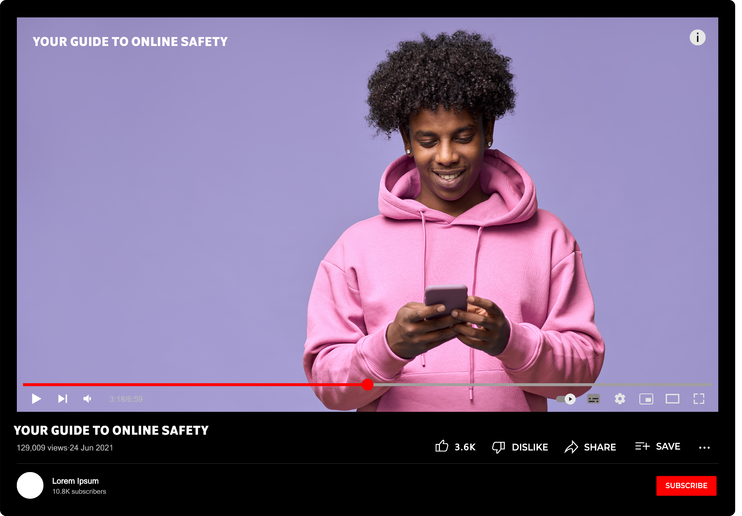
Go to YouTube.com on your desktop.
For the purposes of this activity, find a video and click on the three dots below the video (see image). Click on ‘Report’. If you are signed out of YouTube, proceed to step 4.
Choose either reason for reporting:
  Report a video you are suggesting goes against YouTube's Community Guidelines: After you select the reason and click ‘Next’, you will be able to add more information about why you are reporting the video.
  Report a video that you believe is unlawful: If you think the content is against the law in Ireland, you need to file another type of report. You may need to give an email address, and must provide the URLs of the content you wish to report, and an explanation about why this content is illegal. You have three ways to report potentially illegal videos:
    You can select ‘Legal issue’ in the list of reporting reasons
    After you’ve flagged the video for Community Guidelines violations, you will see an option to file a ‘legal issue’. Click on the link.
    You can also submit a legal complaint through YouTube’s help centre.
If you are signed out, you will see the option to file a legal complaint without signing in. Click on the link.
GROUP ACTIVITY
Reporting content on YouTube
Notes:
Time: 5–8 mins
This is a practical exercise that allows you to talk your students through the steps of reporting illegal content. Sometimes students may think they know how to report something, but they may never have had the experience of doing it.
This activity can be done in a few ways. If your students have access to individual devices, they can follow and complete this activity themselves. If they don’t, you can run through this reporting activity together as a class. This reporting exercise is designed to be done on a desktop computer.
The purpose of this activity is not to make an illegal report, it is just to show students the process for doing it.
Please note: YouTube was chosen for this exercise based on its availability on students' and teachers' devices. If your students can access other devices or platforms, you can choose to look at reporting illegal content on another platform.

Slide 20
Reporting to Coimisiún na Meán
Information relating to online safety and the role of Coimisiún na Meán can be found at: www.cnam.ie/online-safety
Information on what you can report and the reporting process can be found at: www.cnam.ie/onlinecomplaints
Email: usersupport@cnam.ie
IMPORTANT NOTE: Coimisiún na Meán is not a content moderator. This means it doesn’t have the powers to immediately take down an individual post or a video online that you find upsetting, or immediately force the platforms to take it down. Coimisiún na Meán cannot get involved if you disagree with a platform’s decision to take down content or not. Its role is to make sure the platforms systems for content moderation are working effectively in compliance with the law. Under the Online Safety Framework, you should always get a decision from the platform if you report content, and reporting mechanisms should be easy to find and use. If they aren’t, Coimisiún na Meán would like to know. Coimisiún na Meán's teams work to monitor the various platforms and make sure they follow the rules. The fastest way of removing illegal content from the internet is to report it to the relevant platform first.
Notes:
Time: 1 min
The purpose of this slide is to give students the contact details of the Coimisiún na Meán Advice Centre. If you or your students feel online platforms are not fulfilling their duties under the Online Safety Framework (DSA/OSC/TCOR), you can report to Coimisiún na Meán.
Sometimes the public contact the Advice Centre and expect Coimisiún na Meán to take down the post or content that they find upsetting. This is not generally something Coimisiún na Meán can do (except in extreme situations, like a threat to life). Coimisiún na Meán is like a referee, making sure that the online platforms follow the laws. The blue box at the bottom of the slide has more information about this.

Slide 21
How and what to report to
Coimisiún na Meán
Notes:
This final section of the lesson (slides 22–26) provides some scenarios for class discussion. Students will hopefully get a better understanding of when they can and cannot report to Coimisiún na Meán.
Important note:
Coimisiún na Meán is a new organisation. The laws that form the Online Safety Framework are also new. It is understandable that there may be some confusion around what you can and can’t report to Coimisiún na Meán, and it is aware that laws and rules are open to interpretation.
It is hoped that these scenarios clarify this somewhat and give students a better understanding of the role of Coimisiún na Meán and the type of things the organisation can help with. There are some scenarios where Coimisiún na Meán is not the organisation to approach. In these situations, we ask students to consider other routes they could use to solve their issue online. They are also signposted to other professionals or organisations that might be able to help instead.

Slide 22
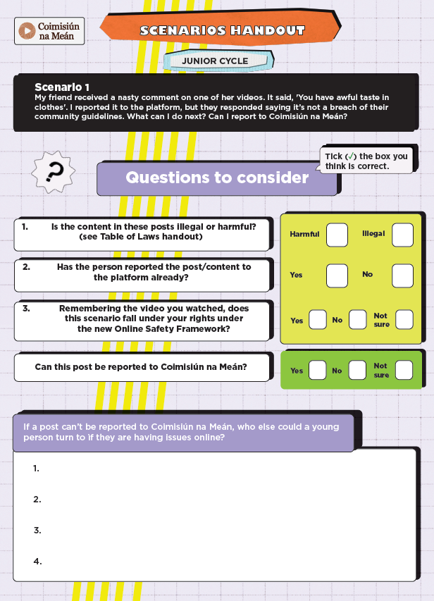
GROUP ACTIVITY
Scenarios
You will need a group of 4–5 students:
Three readers (one to read the FAQ leaflet, one to read the table with the laws, and one to read the checklist).
One notetaker to fill in the template handout.
One spokesperson to discuss their group's answer with the class.
Notes:
Time: 2 mins
This part of the lesson looks at various scenarios that, as a group, your students will need to decide if this is something that can be reported to Coimisiún na Meán or not.
Divide the class into groups of 5 and tell the group there are different roles to fill:
Readers
Notetaker
Spokesperson
Explain to the class that you will do the example scenario together first. From looking at the checklist on the next slide and at the table of laws on slide 15, answer the question: can you report this scenario to Coimisiún na Meán? (YES/NO/I’M NOT SURE)

Slide 23
Can I report to Coimisiún na Meán?
Example scenario
Before reporting to Coimisiún na Meán, complete this checklist:
Did you report/flag the post to the platform first as it might violate their own Community Guidelines?
Is the content in this account/post/video harmful or illegal? Use the table on slide 15 to check.
If it might be illegal, did you report it as ‘illegal content’ to the platform? Remember, this is a different process to reporting/flagging for Community Guidelines (see slide 17).
Did you get a response from the platform about your report?
Is there anyone else you can report the content to?
If you can’t find a way to report, or if you get no response from the platform, you can report the issue to Coimisiún na Meán at usersupport@cnam.ie.
Example scenario: There was a video going around on social media of a fight in my school. I really didn't like it and wanted to report it to the platform but couldn't find anywhere to report it. Can I report to Coimisiún na Meán?
Answer: Yes – under the laws of the Online Safety Framework, platforms should have easy to find and easy to use reporting functions. If they don't, you can report this to Coimisiún na Meán.
While something like a fight is distressing to see, Coimisiún na Meán does not have the power to force platforms to remove content immediately. However, you should be able to report it and get a response from the platform in a timely manner.
If you are upset or worried about something you have seen online, you should always talk to a trusted adult.
Remember: Every query and piece of information sent to Coimisiún na Meán helps it do its job better!
Notes:
Time: 2–3 mins
Before the students debate between themselves in groups, read out the example scenario as a class. Read through the checklist too.
Using the table of laws on slide 15, the checklist on this slide and the FAQs for Students, answer the question: Can the person in this scenario exercise one of their rights online and report to Coimisiún na Meán? Students answer YES/NO/I'M NOT SURE.
In this example scenario, students can report to Coimisiún na Meán.
It is hoped that these scenarios clarify this somewhat and give students a better understanding of the role of Coimisiún na Meán and the type of things Coimisiún na Meán can help with. There are some scenarios where Coimisiún na Meán is not the organisation to approach. In these situations, we ask students to consider other routes they could use to solve their issue online, or they are signposted to other professionals or organisations that might be able to help instead.

Slide 24
Scenarios
Can I report to Coimisiún na Meán?
Scenario 1: My friend received a nasty comment on one of her videos. It said, ‘You have awful taste in clothes’. I reported it to the platform, but they responded saying it’s not a breach of their Community Guidelines. What can I do next? Can I report to Coimisiún na Meán?
Scenario 2: I saw a horrible video online forcing dogs to fight. People keep sharing the video, so I see it a lot. I feel so bad for the dogs as they were getting hurt. I reported it to the platform, but nothing happened. I didn’t get a response and it wasn’t taken down. What can I do next? Can I report to Coimisiún na Meán?
Scenario 3: There was a new challenge recently on social media. A lot of my friends were taking part, but some of them got injured. I’m getting pressured to do this challenge myself, but I don’t want to. If I report this to the platform, what happens? Can I report to Coimisiún na Meán?
Questions to consider:
Is the content in these posts illegal or harmful?
Has the person reported the post/content to the platform already?
Remembering the video you watched, does this scenario fall under your rights under the new Online Safety Framework?
Notes:
Time: 4–8 mins
You will need per group: x 1 print out template, x 1 FAQs, x 1 table of laws, x 1 checklist
Give each group of 5 a scenario. You could give one side of the room Scenario 1. The middle section of the room could get Scenario 2 and the further side of the room could get Scenario 3.
Print off and give each group the various handouts. Explain they need to discuss the various scenarios and decide as a group if this instance could be reported to Coimisiún na Meán (YES/NO/I’M NOT SURE).
Allow 4–5 minutes for discussion and then feedback as a group together.

Slide 25
Scenario answers
Scenario 2 I saw a horrible video online forcing dogs to fight. People keep sharing the video, so I see it a lot. I feel so bad for the dogs as they were getting hurt. I reported it to the platform, but nothing happened. I didn’t get a response and it wasn’t taken down. What can I do next? Can I report to Coimisiún na Meán?
Scenario 3 There was a new challenge recently on social media. A lot of my friends were taking part, but some of them got injured. I’m getting pressured to do this challenge myself, but I don’t want to. If I report this to the platform, what happens? Can I report to Coimisiún na Meán?
Scenario 1 My friend received a nasty comment on one of her videos. It said, ‘You have awful taste in clothes’. I reported it to the platform, but they responded saying it’s not a breach of their Community Guidelines. What can I do next? Can I report to Coimisiún na Meán?
Answer: No – in this instance, Coimisiún na Meán doesn’t have the power to force the platform to remove the comment. Coimisiún na Meán would like to know if a platform doesn't have a way to report accounts, comments, videos or posts.
A comment like ‘you have awful taste in clothes' isn’t nice, but it is not illegal. Your friend might be able to delete the comment on the post and block the person who wrote it. It is also important to talk to a trusted adult if you or your friends find anything upsetting online. While in this situation, Coimisiún na Meán cannot force platforms to remove this comment, it is still unacceptable behaviour.
Answer: Yes – under the laws of the Online Safety Framework, platforms should remove illegal content and, if they don’t, you can report to Coimisiún na Meán.
Animal cruelty and the encouragement of animal fighting is against the law under Section 15 of the Animal Health and Welfare Act, 2013 (see slide 15) and it may also violate a platform’s Community Guidelines.
If you have reported this as illegal content to the platform, you should get a reply. If the content isn't removed or if you don't receive a response from the platform, you can report to Coimisiún na Meán.
Answer: Yes – you can report to Coimisiún na Meán, but you should report this to the platform first. Your report is anonymous, and no one will know you reported it. If these challenges are a risk to life, you should report it to your local Garda station.
As this is harmful content, you can also contact Coimisiún na Meán if you are unsure where to report and they can advise you further.
It is very important to talk to a trusted adult as this behaviour could put someone at serious risk of injury.
Notes:
Time: 4–5 mins
Ask each nominated spokesperson to give their verdict on their scenario: Can you report to Coimisiún na Meán? YES/NO/NOT SURE
Go through their answers before revealing the answers on the next slide.

Slide 26
Who else can I go to for help or advice?
When you were working on the scenarios, did you think about any of these organisations who could help?
An Garda Síochána*
Childline
ISPCC Teenline
Samaritans
Spunout
Bodywhys
Hotline **
Teacher/principal/guidance counsellor
Parent/guardian/trusted adult
GP/counsellor
* Whenever there is a threat of violence or threat to life or limb, or intimate images have been shared, the Gardaí should be contacted immediately.
** You can also contact Hotline.ie regarding child sexual abuse images and intimate image sharing.
Notes:
Time: 1 min
The purpose of this slide is to outline that there are many other organisations that might be able to help. Seeing illegal or harmful content can be distressing and it is important for students to know that they can talk to a trusted adult or professional if they are worried or upset about something they saw online.

Slide 27
What we covered in this lesson
Rights: You considered the rights you have online.
Rules: You learned about the new rules that exist in Ireland to regulate online platforms, and the role of Coimisiún na Meán, Ireland’s media regulator.
Reporting: You practiced how to report illegal and harmful content and discussed scenarios in relation to reporting illegal content to Coimisiún na Meán.
Notes:
Time: 1 min
Recap slide

Slide 28
Main Takeaways
In the past, it may have felt like there were no rules or laws on the internet. Now, there are new rules that protect your rights online and make platforms more accountable.
Always report to the platform first if you see harmful or illegal content online.
If you are unsure about/need help reporting, please get in touch with the Advice Centre at Coimisiún na Meán: usersupport@cnam.ie
Coimisiún na Meán does not have the power to immediately remove content online, or force online platforms to remove said content. Its role is to make sure that online platforms’ content moderation and reporting systems are working effectively in compliance with the law.
Notes:
Time: 1 min
Key takeaways from the lesson.

Slide 29
Reflection and Action
Reflection: Something new I have learned is …
Action: One thing I will do differently
is …
Notes:
Time: 2 mins
Ask students to write their reflection into their copies.
It is very important to allow time for your students to reflect on what they have learned in this lesson.

Slide 30
Click here to do a quick student survey
Thank you!
Notes:
Time: 3–5 mins
Coimisiún na Meán would be very grateful if you could ask your students to fill in a 3-minute survey found here: https://forms.office.com/e/cM99982tZj
A teacher survey can be found in the Teacher’s Guide and here: https://forms.office.com/e/SVctzjG7nz
This helps the organisation understand what worked and what it might change in any future educational resources.

